Slide 1

Particle Swarm Optimization (PSO)
© 2020 KL University – The contents of this presentation are an intellectual and copyrighted property of KL University. ALL RIGHTS RESERVED

Slide 2
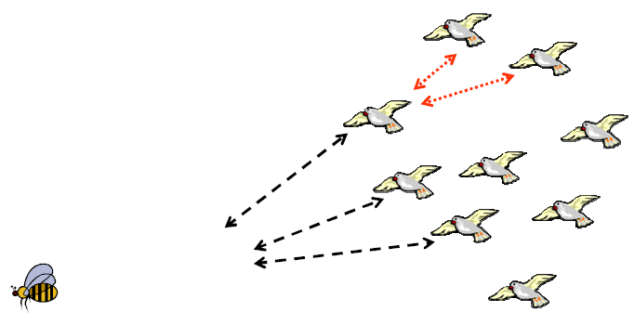
Particle Swarm Optimization (PSO)
© 2020 KL University – The contents of this presentation are an intellectual and copyrighted property of KL University. ALL RIGHTS RESERVED

Slide 3
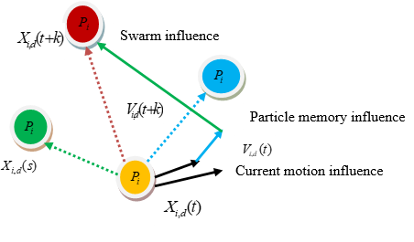
© 2020 KL University – The contents of this presentation are an intellectual and copyrighted property of KL University. ALL RIGHTS RESERVED

Slide 4
1. Each particle evaluates the function to maximize at each point it visits in spaces.
2. Each particle remembers the best value of the function found so far by it (pbest)
3. Secondly, each particle know the globally best position that one member of the flock had found, and its value (gbest).
Using the co-ordinates of pbest and gbest, each agent calculates its new velocity as:
v_{i} (t+1)= w*v_{i}(t)+ c₁ x rand() x (x_{pbesti} –x_{i}) + c₂ x rand() x (x_{gbesti} –x_{i})
x_{i}(t+1) = x_{i}(t) + v_{i}(t+1)
where 0 < rand() <1, 0< c_{1 ,}c₂ <2 and 0<w<1
© 2020 KL University – The contents of this presentation are an intellectual and copyrighted property of KL University. ALL RIGHTS RESERVED

Slide 5
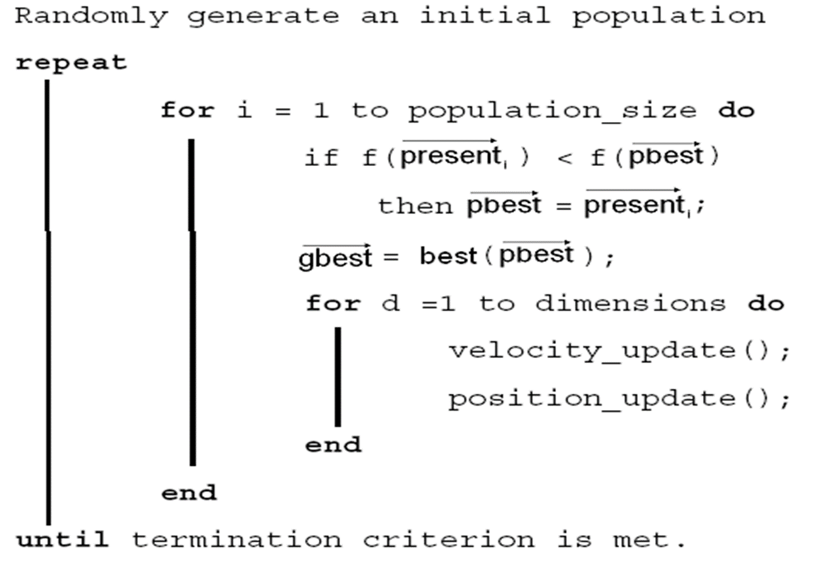
© 2020 KL University – The contents of this presentation are an intellectual and copyrighted property of KL University. ALL RIGHTS RESERVED

Slide 6
Applying PSO to a simple function
P) Min. f(x) = x₁²+ x₂²
^{-5< x1, x2< 5}
^{Sol:}
^{Initialization:}
Wc = 0.7,C1=1.49445,C2=1.49445,R1=0.0,R2=0.0;
S 5
D 3
I 5

Slide 7
Initial Swarm of 5 Particles:
Particle 1 (-3.510000, 0.890000,1.150000): Fitness:14.434700
Particle 2 (3.830000, -0.580000,-1.430000): Fitness:17.050200
Particle 3 (4.710000, 1.680000,0.300000): Fitness:25.096500
Particle 4 (4.620000, 2.530000,1.880000): Fitness:31.279701
Particle 5 (-3.290000, 2.250000,-1.450000): Fitness:17.989100
Global Best is Particle No: 1 with Fitness 14.434700

Slide 8
Iteration no 1: with Global best Fitness:14.434700
===========================================
Particle 1 (-3.510000, 0.890000,1.150000): Fitness:14.434700
Particle 2 (-5.000000, -0.430615,0.243366): Fitness:17.050200
Particle 3 (-5.000000, 1.557216,1.054548): Fitness:25.096500
Particle 4 (-5.000000, 0.583987,1.419620): Fitness:27.356359
Particle 5 (-3.582284, 0.766310,-0.136677): Fitness:13.438673

Slide 9
Iteration no 2: with Global best Fitness:13.438673
===========================================
Particle 1 (-3.522207, 0.870036,-0.640197): Fitness:13.572756
Particle 2 (-5.000000, 0.535008,1.040329): Fitness:17.050200
Particle 3 (-0.804893, 0.627017,0.663556): Fitness:1.481308
Particle 4 (-5.000000, -0.745877,0.307554): Fitness:25.650921
Particle 5 (-1.076494, -0.384058,0.886692): Fitness:2.092564

Slide 10
Iteration no 5: with Global best Fitness:1.045546
===========================================
Particle 1 (2.300471, 0.016760,-1.879039): Fitness:3.418265
Particle 2 (0.452939, 0.135487,0.668925): Fitness:0.670971
Particle 3 (-1.568897, 0.839667,0.740664): Fitness:1.481308
Particle 4 (2.786638, 0.336669,1.488011): Fitness:1.149330
Particle 5 (0.300884, 0.281356,0.384458): Fitness:0.317500
=======================================
Final Solution(0.300884, 0.281356)with Fitness: 0.317500.

